Slide 1
Chapter 16
Event-Driven Programming (cont.)

Slide 2
After this lecture, you should be able to
Use interface adapters
Handle key events
Use the Timer class for animation

Slide 3
Listener Interface Adapters
&
The Timer Class

Slide 4
Interface Adapters
Adapters provide default implementations for all the abstract methods (handlers) in interfaces
  Mainly with empty method bodies
Why? So that you don’t have to override every single handler yourself
  You may not need all the handlers
  For example, a listener interface may have 10 abstract methods for you to override, but you need only one.

Slide 5
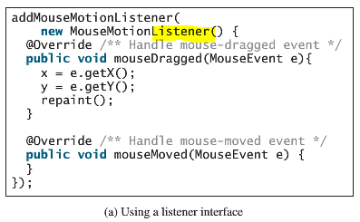
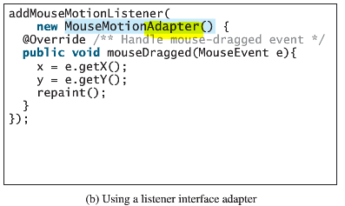
How do I use an interface adapter?
Instead of this…
Do this…

Slide 6
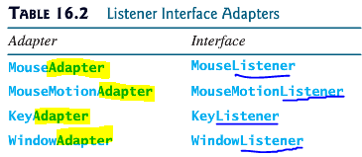
How do I know what adapters to use?
Not all interfaces have their corresponding adapters
  For example, ActionListener, simply because there is only ONE abstract method
A listener interface adapter is named XAdapter for XListener.

Slide 7
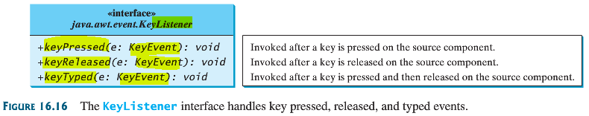
KeyListener
The interface to implement:
KeyListeners or KeyAdapters
The methods (handlers) you can override:
keyPressed, keyReleased, keyTyped

Slide 8
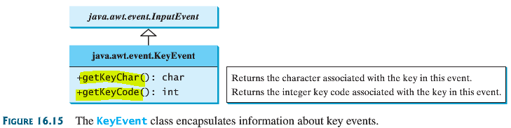
KeyEvent Objects
What can you do with the event object argument in a handler?
  Get the key character
  Get the key code

Slide 9
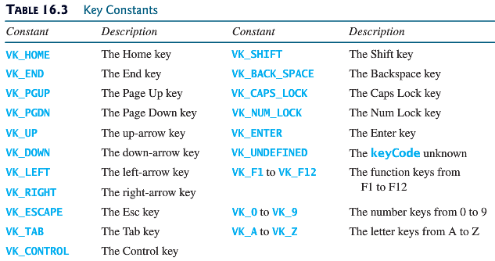
What is a key code?
If a character is an Unicode character, then the key code is its Unicode value
JAVA API provides a complete list of constants for some key codes, some of them are:

Slide 10
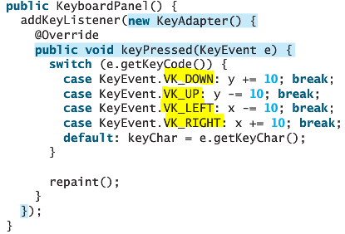
Example
This handler is overridden to change x and y coordinates based on page up/page down/up arrow/down arrow values:
Invoking the
repaint() method causes paintComponent to be invoked, which displays the message in a new location.

Slide 11

Set or request “focus”
(See: LISTING 16.10 for more)
What is a “focus”?
  “Focus” here means “selected and in use”
  Only a focused component can receive KeyEvent
Example: setting focus to a panel
Example: Request focus for a component whose top level window is in focus:

Slide 12
The Timer Class
Recap: Up to this point, we create a component (e.g. button), create a listener class by implementing an interface and override the handlers. We then create an object of this custom listener and register (attach) it with the component
We can also create a Timer object, create a listener class by implementing an interface and override the handlers. We then create an object of this custom listener and register (attach) it with this timer object

Slide 13
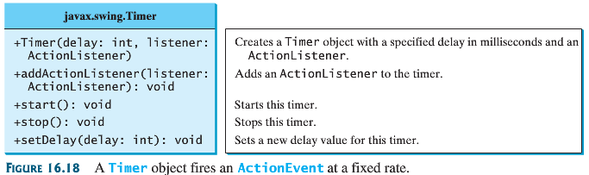
The Timer API

Slide 14
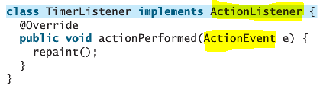
Define a custom Timer listener
Remember that ActionEvents are meant to be fired by Timer objects and buttons
Invoking the
repaint() method causes paintComponent to be invoked, which displays the message in a new location.

Slide 15
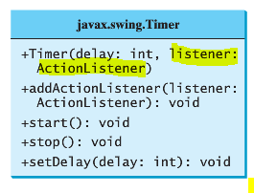
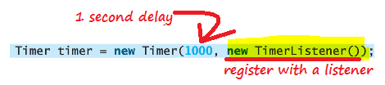
Registering a timer object with a listener
“setDelay” sets the number of milliseconds between two action events

Slide 16
Demo - Animation
Watch my JAR executable from Listing 16.11

Slide 17
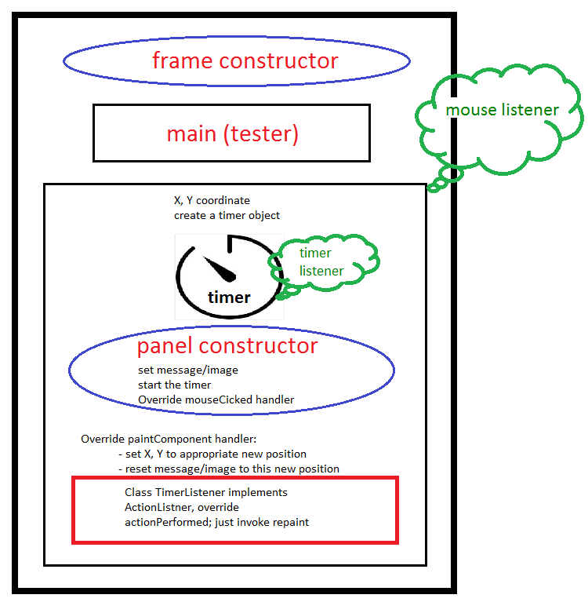
Program Structure

Slide 18
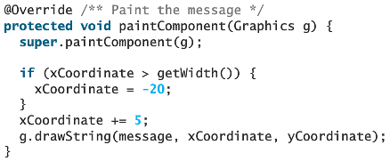

“repaint” invokes “paintComponent”
This paintComponent is overridden to set values to the x-coordinate for the string to move to a new location on a canvas

Slide 19
Exercise/Competition
First 3 students to complete this assignment gets a free 16GB flash drive
Search or free clipart, create two images of a person making two steps
Animate the person walking across the canvas (panel)
  Add a mouseLister to adjust delays
    Use buttons 1 and 3
When the person walks off the screen on the right, make him re-enter from the left and repeat walking

